Slide 1
Documentation of Software Engineering
Presenter
Md Alamgir Kabir
sagar.whu@outlook.com

Slide 2
Outline
Basic Features of a Document
Guidelines

Slide 3
The Basic Features of a Document
- introduction, which emphasize problem solving. - Tutorial begins with basic function and builds to advanced. - document is organized by modules which help users identify discrete tasks to learn. - document uses examples from the user’s work place. - overview helps orient the learner to the task. - icons help the user see where to click and reinforces the text. - explicit instructions limit the user’s options. (click cancel – you do not need to create a new worksheet-) - graphics shows novice user exactly what to do. - steps keep the user focused on one task a time, using work place examples.

Slide 4
GUIDELINES

Slide 5
Guidelines
1- identify skills you need to teach 2- state objectives as real-world performance: - Objectives should appear as skills that the user should learn as a result of the tutorial. - Often objectives sound like “ in chapter x, you will learn the following skill…” so tell the user what he or she will learn from the lesson, and put the objectives in measurable terms ex. “ this lesson will teach you to create a drawing with three colors”. -At the review the objectives and direct toward the next lesson.

Slide 6
Guidelines
3- choose the right type of tutorial. A) The guided tour: a guided tour presents an overview of the program features to a user unfamiliar with them. It is an overview of program features that informs and persuades the user as to the usefulness of the program in a low-interaction environment. It focuses on the entire program capabilities and user actions like main screens and useful commands. Usually the tour will follow a made-up example with a little user interaction, it tells the program features and it also helps convince the user of the usefulness of the program.
The online consists of screens and messages boxes explaining the prominent features of the program.

Slide 7
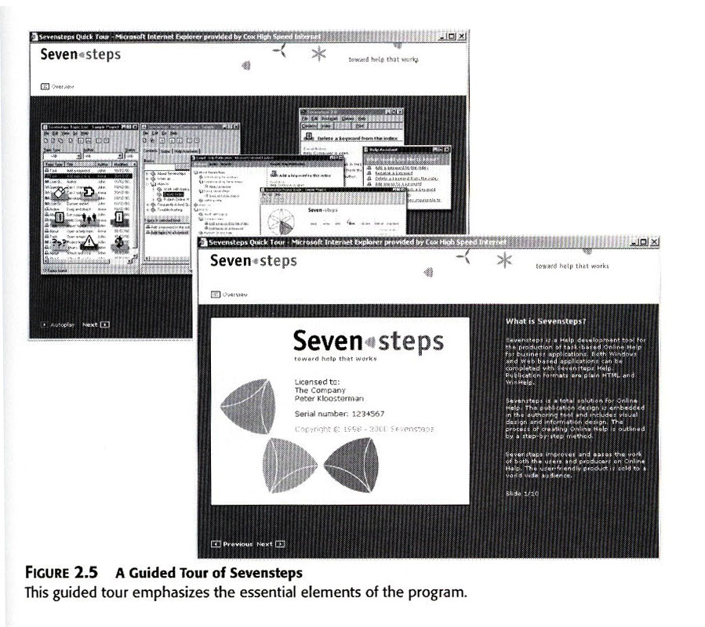
Guidelines

Slide 8
Guidelines - Definition – Guided Tour
TOURISM a short journey around a building or place with a person who tells you about what you are seeing or with a pair of headphones on which you can listen to a recorded description of what you are seeing Thesaurus entry for this meaning of guided tour COMPUTING an explanation of how to use a website or a piece of software that you read on a computer screen by clicking on a series of buttons or links Thesaurus entry for this meaning of guided tour

Slide 9
Guidelines
B) Demonstration, design a demonstration when
specific parts of a program , perhaps for a specific user, usually you use an example of the program, often a limited version of the program. It is a more focused presentation of a particular program function being performed, which tends to be passively viewed by users. The user will observe passively- no interaction- , like the guide tour, it informs and persuades. The tutorial instructs the user in starting the program and tells the user what commands to use to perform the demonstrated procedure.

Slide 10
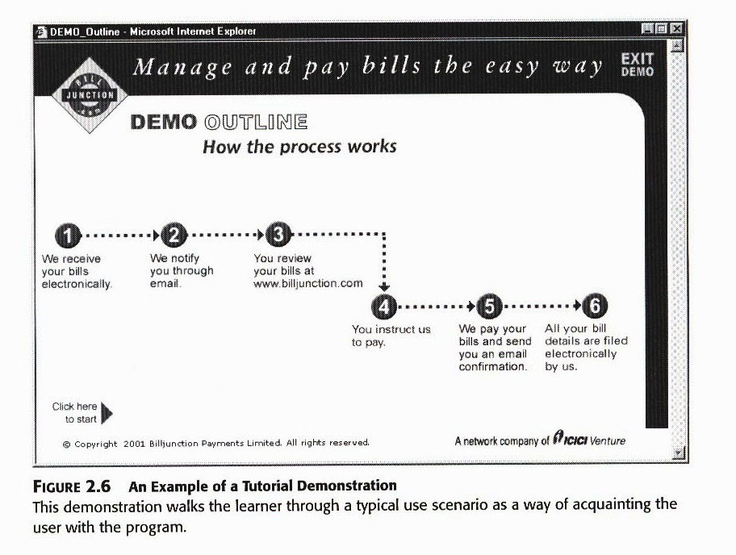
Guidelines

Slide 11
Guidelines
C) The quick start, It differs from the previous two forms, it is for experienced to advanced users with domain knowledge who want to get going with a program.
It involves significant user interaction with the program itself, and rarely uses examples. It is a form of documentation that is generally aimed at more advanced users and provides the basic information that one needs to dive into the program and interact with it on their own. This type help users get down to work, basic and advanced procedures.
It consists of one page or folded cards that explain how to start the program and list of commands.

Slide 12
Guidelines
D) The guided exploration
This kind of tutorials contain instructions for the user to “try out” commands which encourage exploration of the program.
It contains a little discussion to give the users the experience they need. It guides a user through a procedure, but allows for some experimentation on their own.
Usually it takes a form of short tutorial manuals, may or may not provide some scenarios (examples to follow), may include objectives and summaries to give the user direction but do not constrain him to learn specific commands.

Slide 13
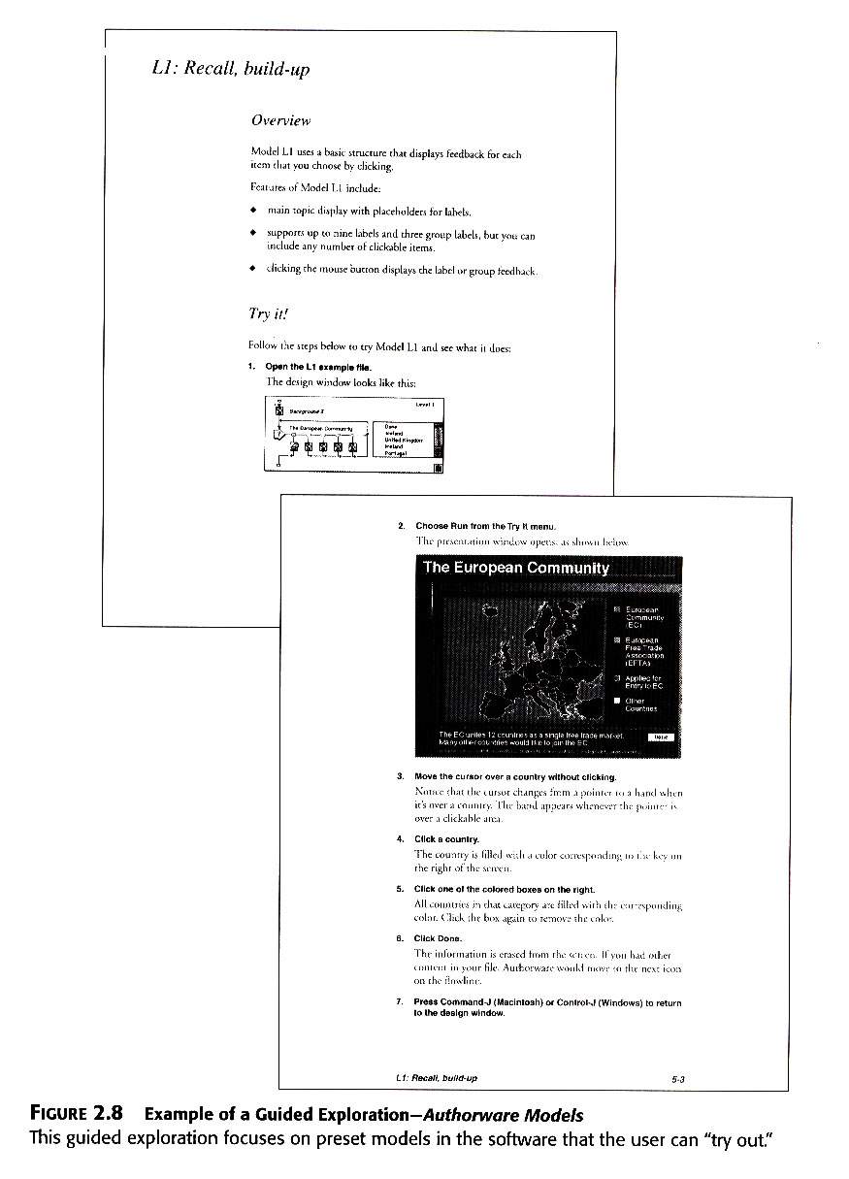
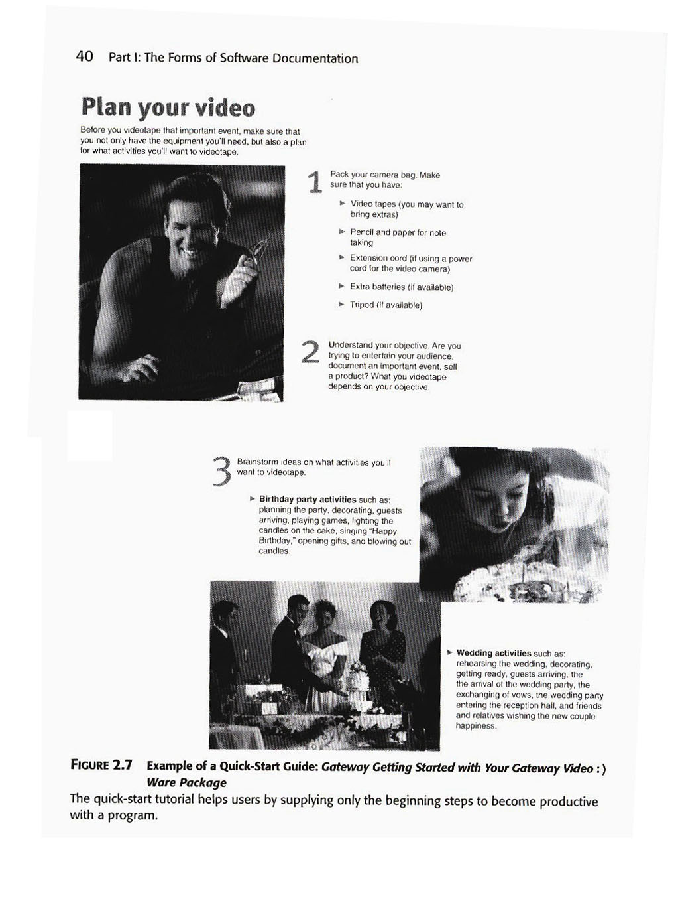
Guidelines

Slide 14
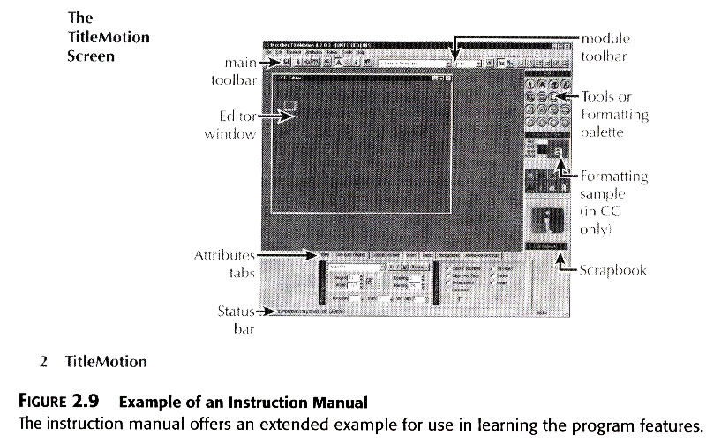
Guidelines
E) The instruction manual,

Slide 15
Guidelines
4-present skills in a logical, cumulative structure
5- Offer highly specific instructions
6- give practice and feedback at each skill level

Slide 16


